Slide 1



Chilli Bean
Choose a card
1
2
3
4
5
6
7
8
9
10
11
12
13
14
15
16
17
18
19
20
21
22
23
24

Slide 2






Chilli Bean
Shiver
& Shake

Slide 3





Broad Bean
Make yourself very wide

Slide 4



Runner Bean
Run on the spot or around the room

Slide 5


Jumping Bean
Jump in the air

Slide 6




Baked Bean
Sunbathe on the beach!

Slide 7




Jelly Bean
Wobble like a jelly

Slide 8






Frozen Bean
Shiver &
shake

Slide 9

Growing Bean
Start small
& stretch up

Slide 10
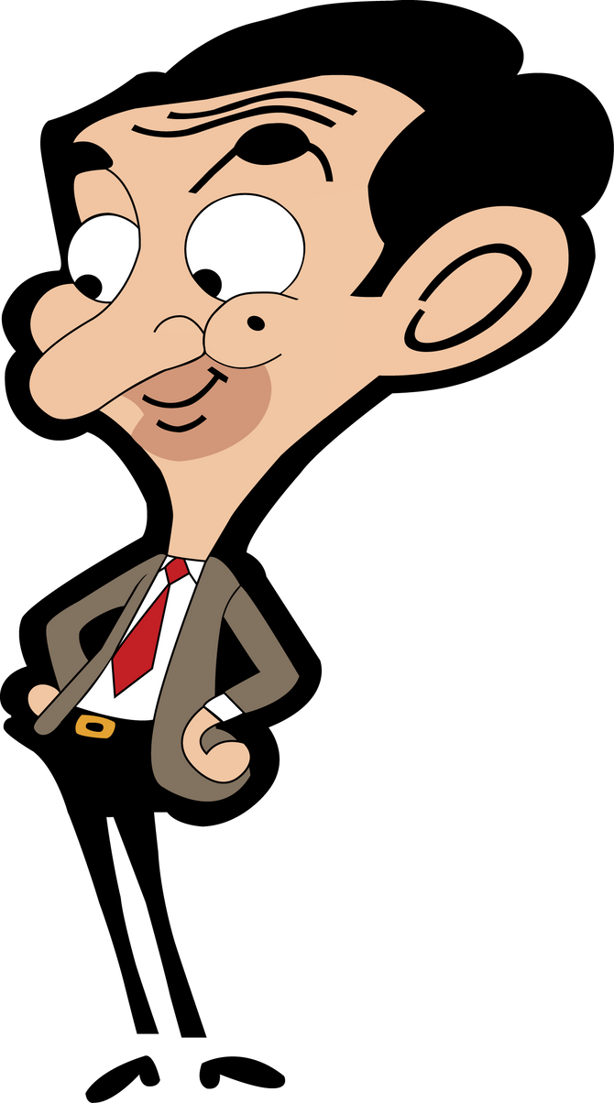



Mr Bean
Look puzzled
& mutter

Slide 11

String Bean
Stand tall and stretch

Slide 12




French Bean
Wave and say 'Bonjour'

Slide 13


Back to Back Bean
Stand
back to back with someone

Slide 14

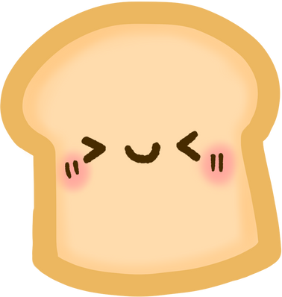

Butter Bean
Spread butter on your bread

Slide 15


Human Bean
Show your muscles

Slide 16





Santa's Bean
Pass someone a present

Slide 17


Full of beans
Look very excited

Slide 18



Where've You Bean?
Look puzzled

Slide 19
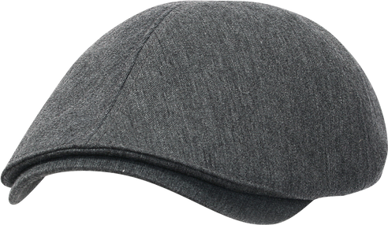


Old Bean
Look old with a walking stick

Slide 20


Beanstalk
Climb the beanstalk

Slide 21



Magic Bean
Cast a magic spell

Slide 22


Happy Bean
Show your biggest smile

Slide 23




Spring Bean
Crouch and spring up

Slide 24




Super Bean
Show your super hero stand

Slide 25


Beanoculars
Look through your binoculars

Slide 26

www.SENDCO.co.uk

